Slide 1
URD Database Project
June 1, 2026

Slide 2
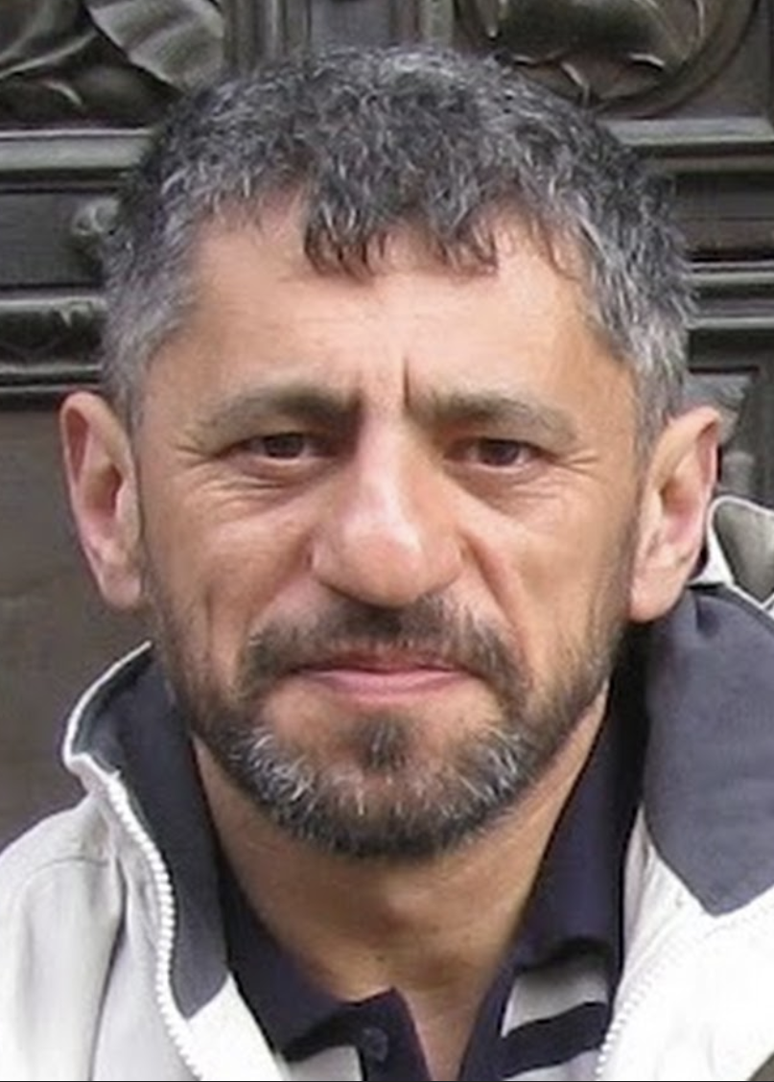
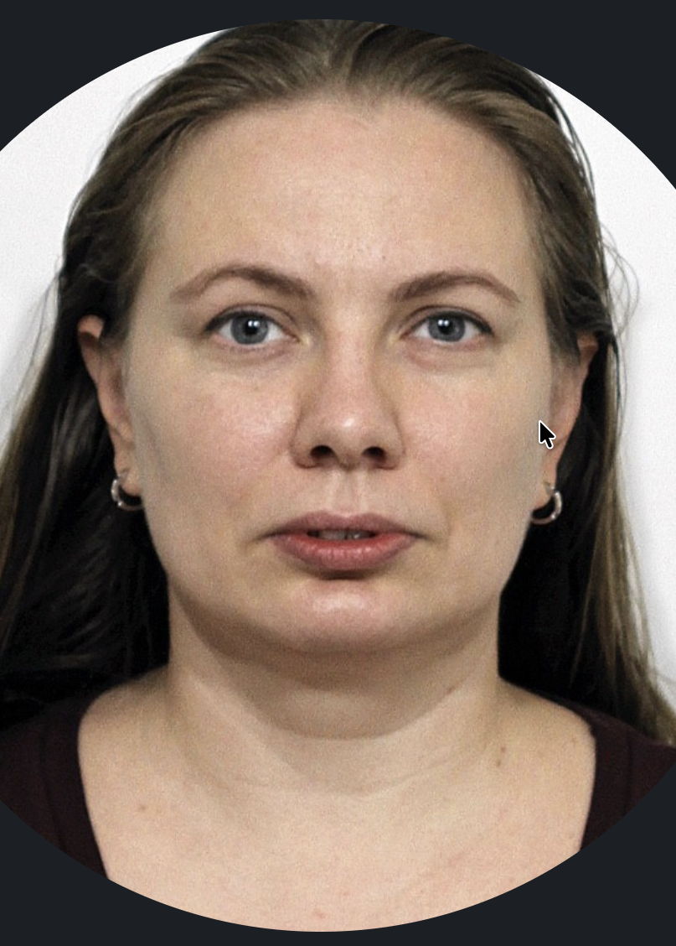

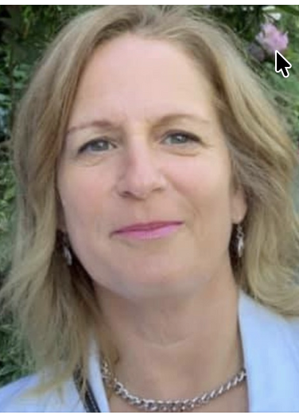

URD Database Team
Alex Zaslavsky
Oxana Fedorova
Juliana Berland
Wendy Citron
Jon Brandt
Developer
Content Checker
Acquisition Lead
Project Manager
Developer

Slide 3

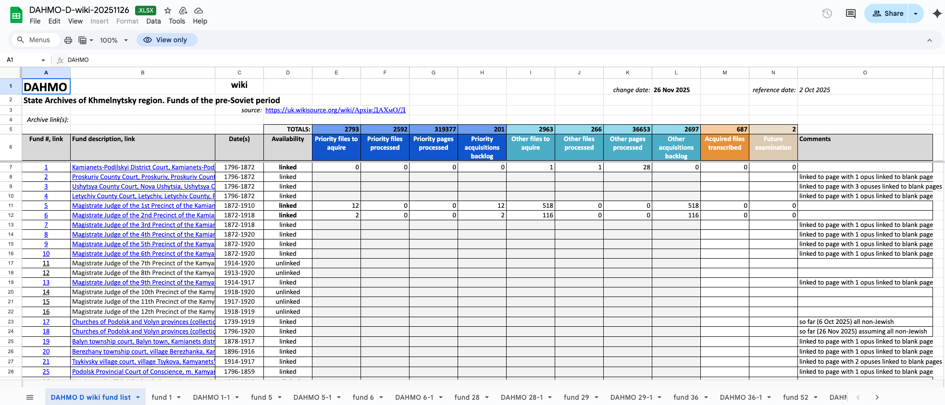
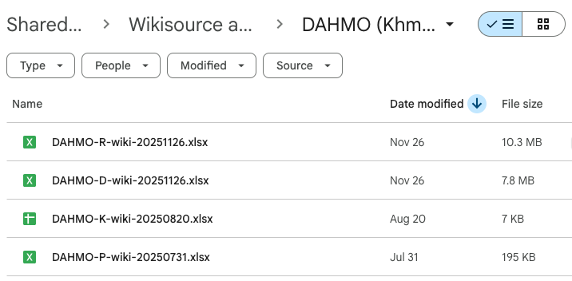
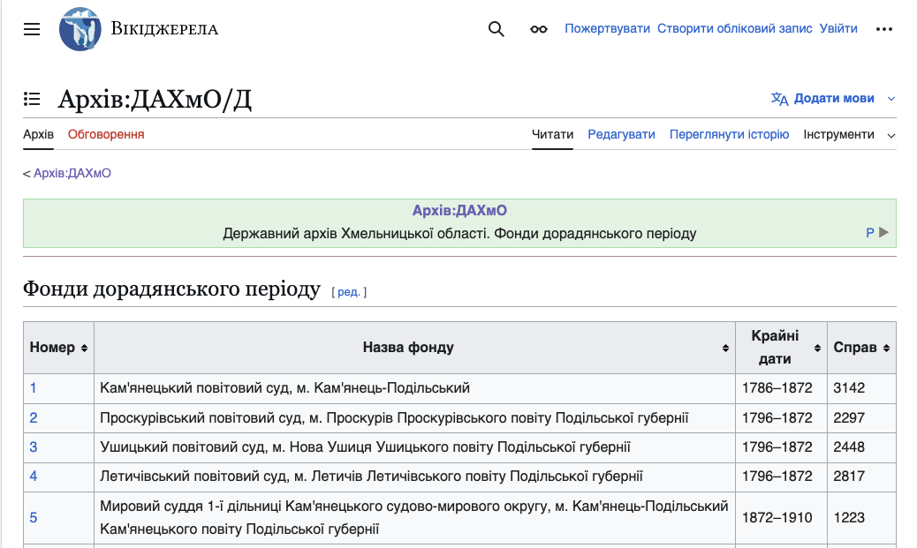

JewishGen URD Acquisition Birds-Eye View

Slide 4
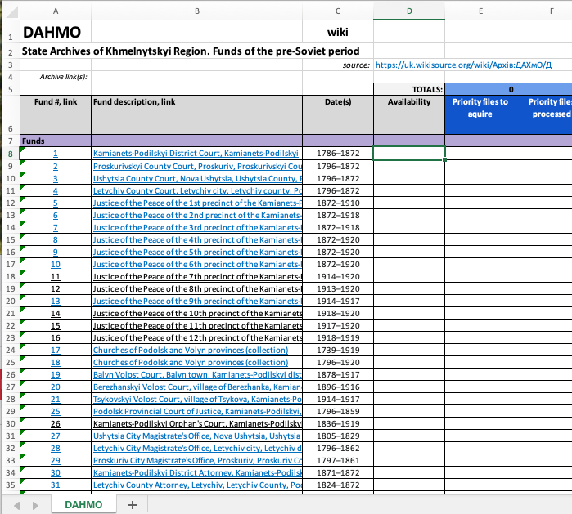
Existing Administrator Workflow
10,000+ changes per month
Overwhelming email notifications
😰
https://uk.wikisource.org
Copy/paste by the 100’s or 1,000’s
150,000+ pages to track

Slide 5
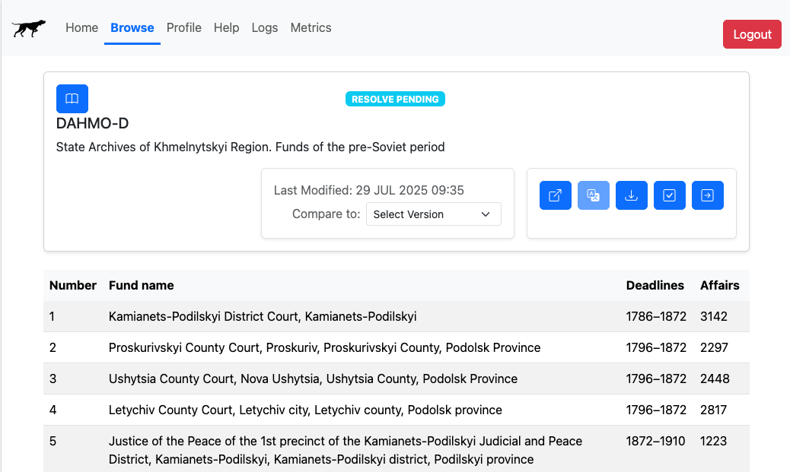
Birddog-Assisted Workflow
Built-in translation
😊
Automated spreadsheet generation
Streamlined change review
Consolidated change alerts

Slide 6
JewishGen URD Acquisition Birds-Eye View

Slide 7
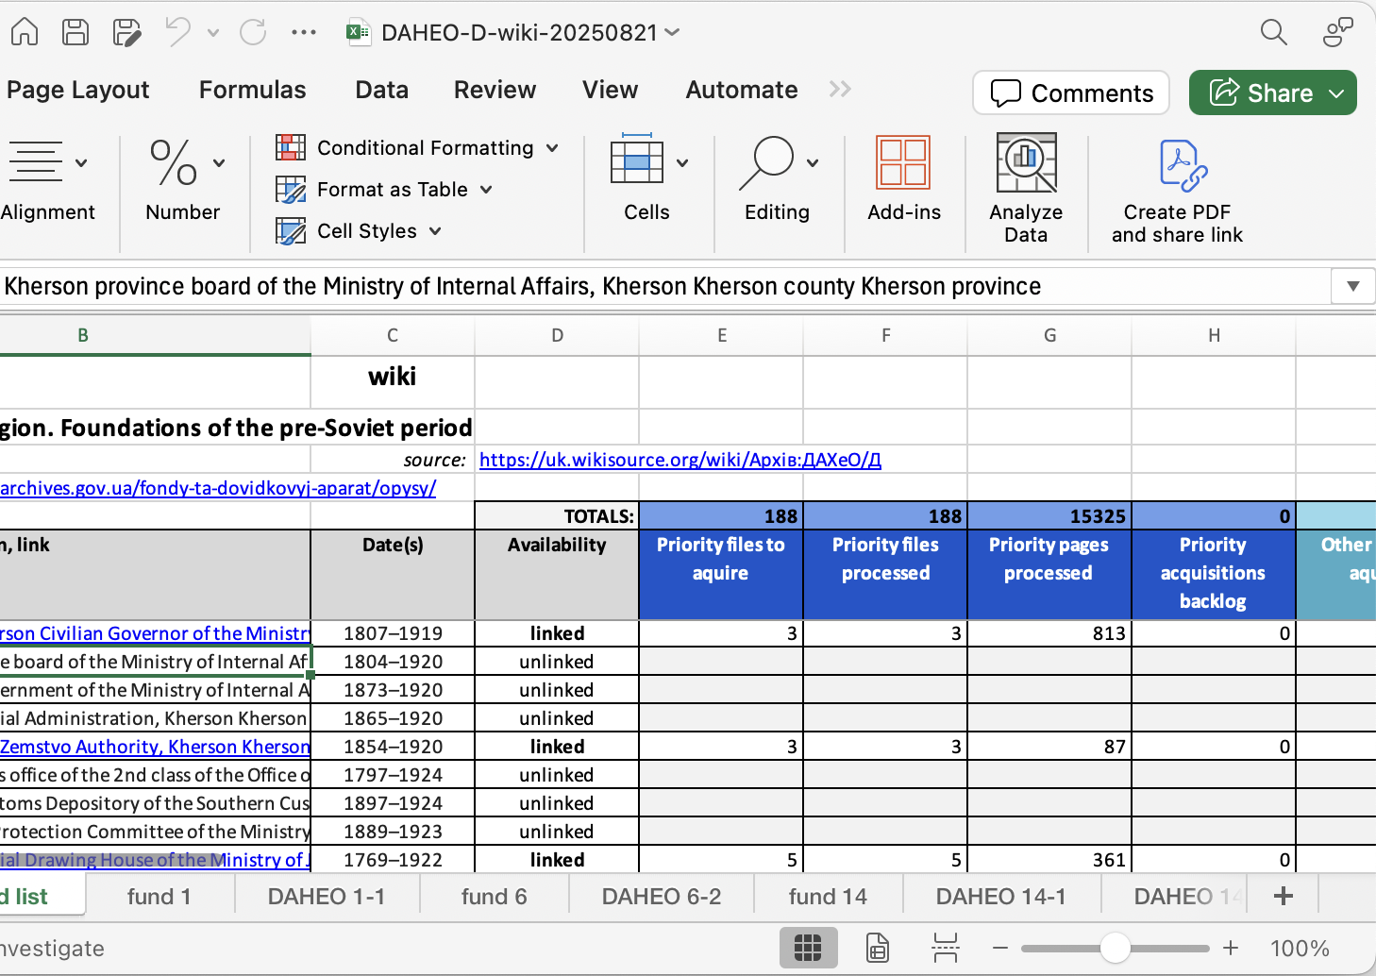
URD Data Problem
Labor intensive to maintain
Fragile multi-tab relationships
Inflexible sheet structure
Not scalable
Error prone

Slide 8
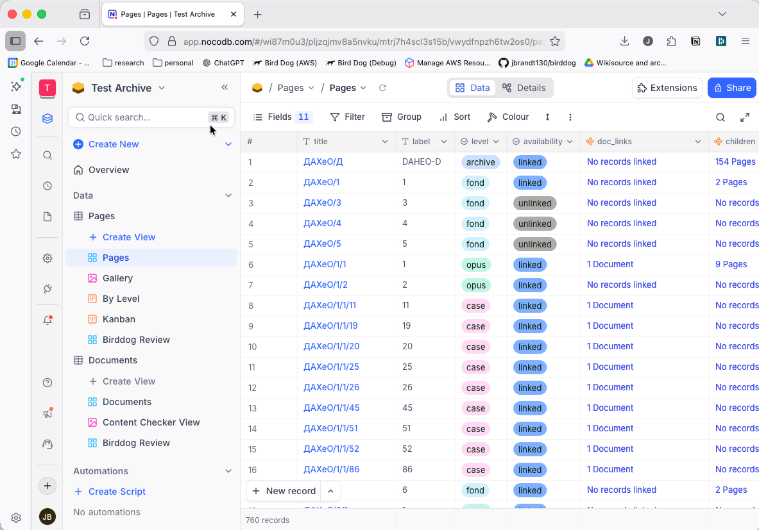
Solution: Replace Spreadsheets with Unified Database
Improved Quality and Accuracy
Scales
Reduces errors
Streamlines
Automates
Adapts and evolves
Reduced Backlog
Increased Volunteer Engagement
Lower Cost

Slide 9




Development Status
Ongoing Work
Google Drive
Wikisource
Birddog
Snapshots
Birddog Integration - automatic updates from Wiki
Data import from spreadsheets
Database
Database Development
Workflow development (views, roles, streamlining)
Transition the URD process to the database platform

Slide 10
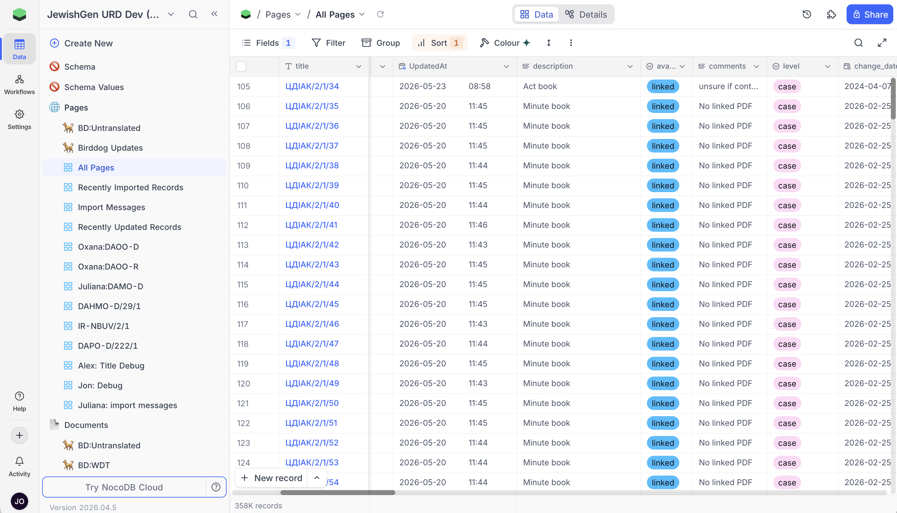
Current Database Scale
Most of Google Drive data is in
358k Page records
171k Document records

Slide 11

Needs to Move Forward
JewishGen IT technical contact for Birddog migration
Support to establish Nocodb Cloud Enterprise plan
JewishGen IT partnership for ongoing operations

